Slide 1
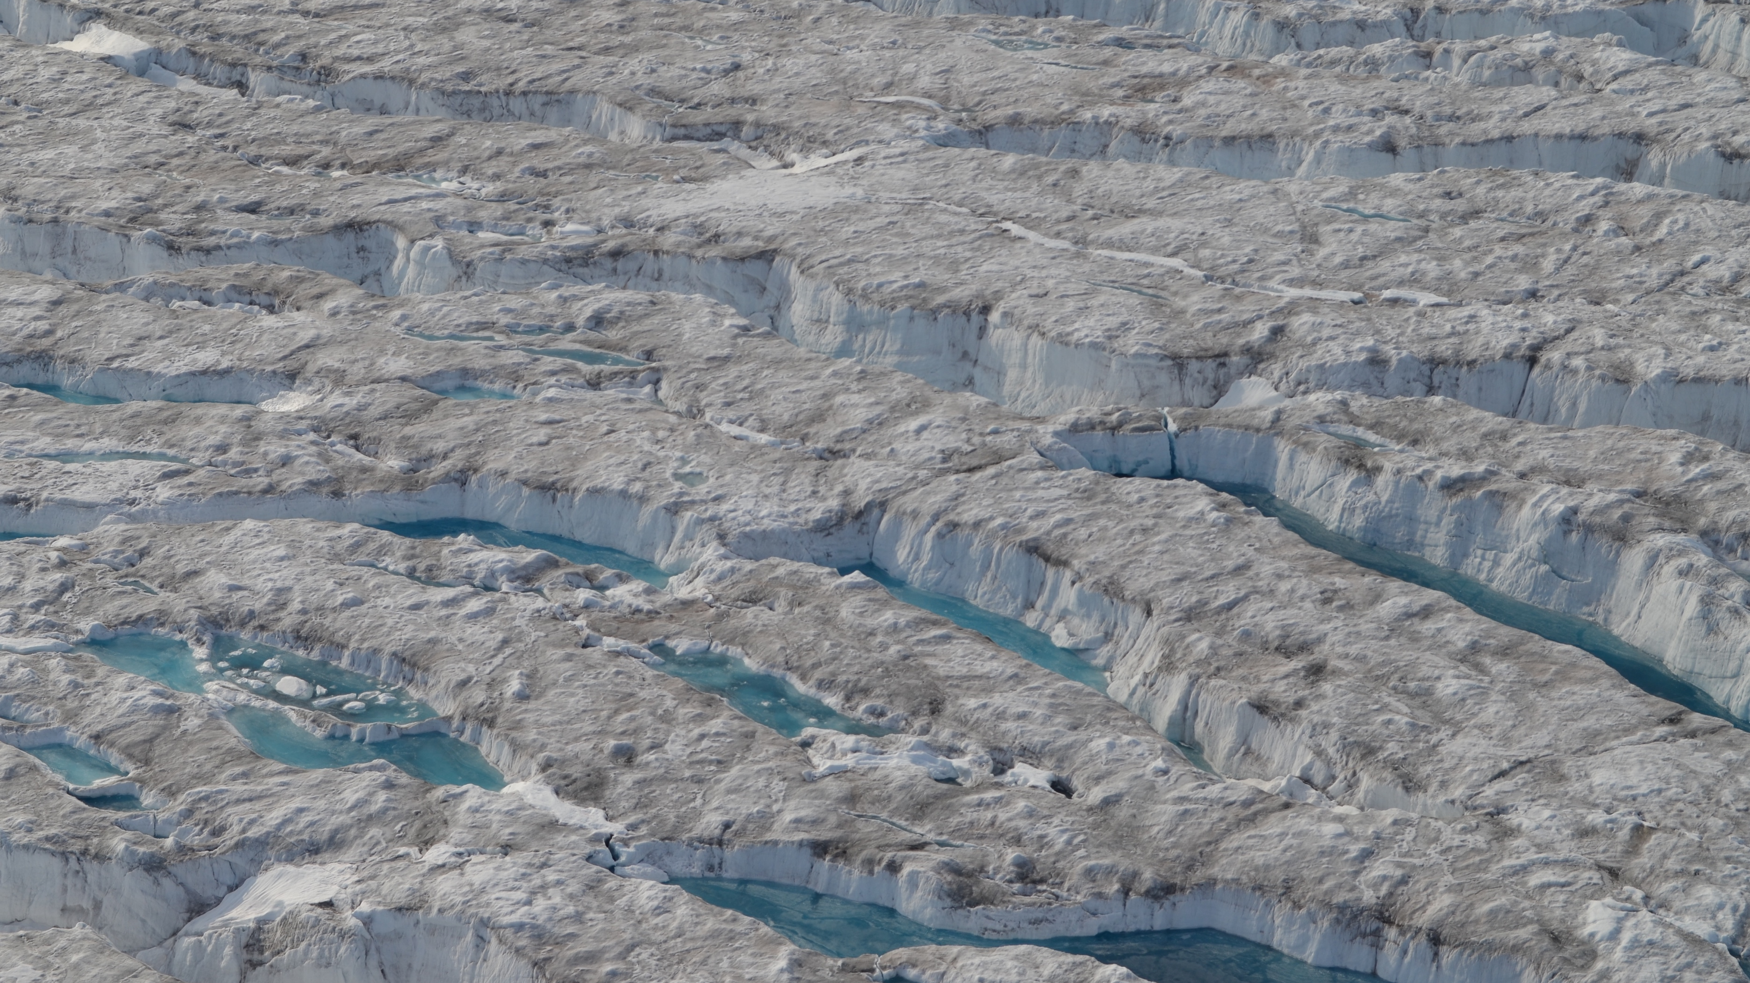
Supraglacial Water Signatures Reflect Changes in Ice Dynamics A Case Study of the Surge of Negribreen, Svalbard
Rachel Middleton¹, Ute Herzfeld¹, Thomas Trantow¹
¹ Geomathematics, Remote Sensing, and Cryospheric Science Laboratory,
University of Colorado Boulder
Photo credit: Ute Herzfeld, Negribreen, Svalbard, 13 August 2019
Notes:
-Rachel, Geomath group
-co-authors Dr. ute Herzfeld and Dr. Tom Trantow
-Supraglacial water signatures detected on Negribreen Surge Glacier reflect changes in its dynamics

Slide 2
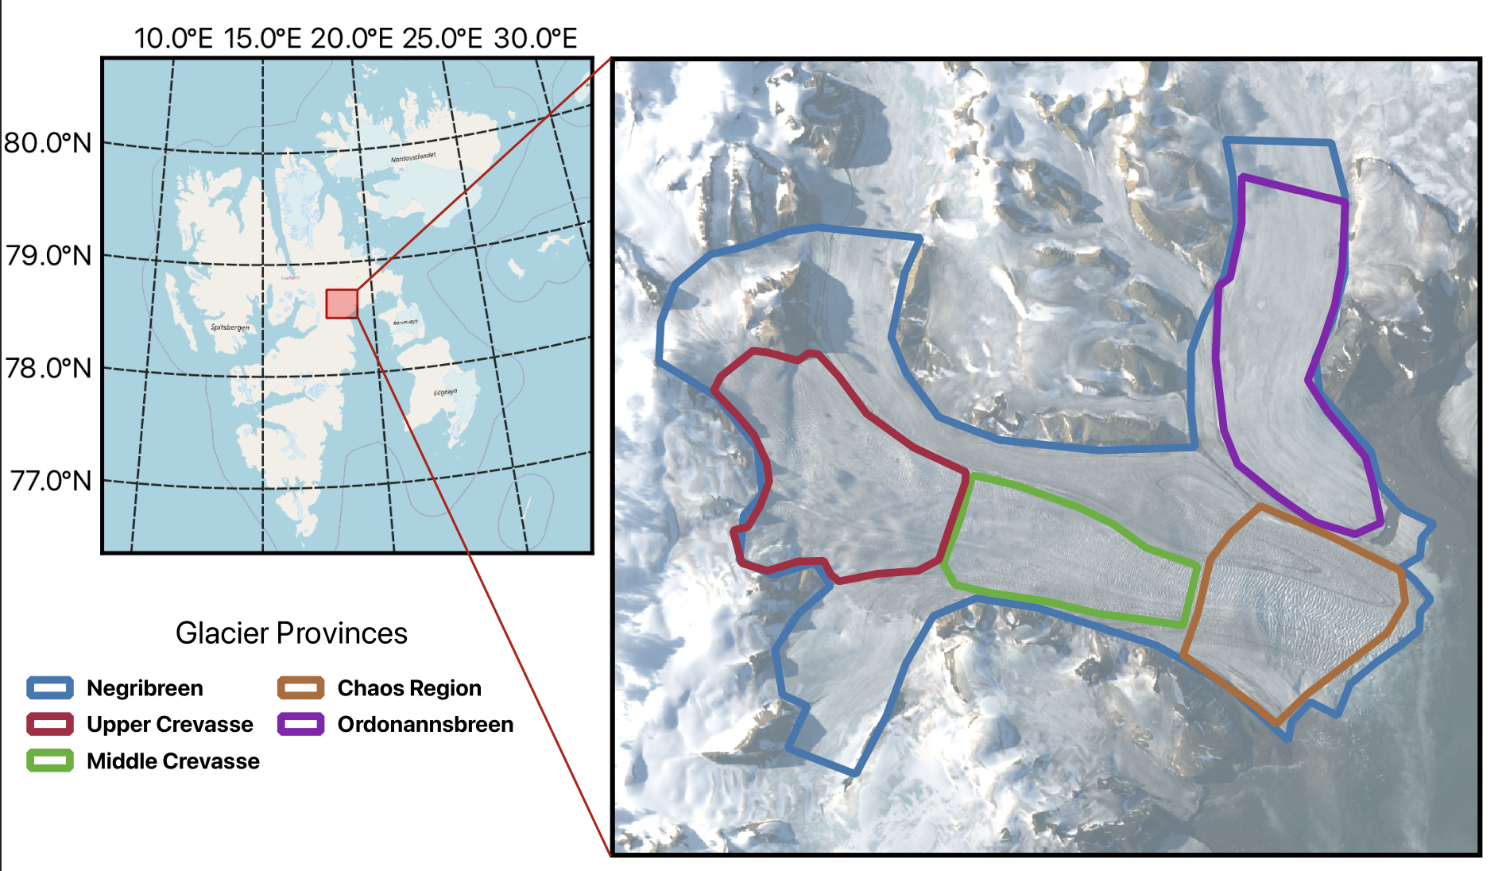
Negribreen Glacier System, Svalbard
Water ponds on the surface, and becomes more extensive as the surge progresses
What might this tell us about water at the bed?
Polythermal, but surging can’t be controlled by thermal switching (Sevestre 2015)
Notes:
NGS is a system of glaciers in the Arctic archipelago, Svalbard Negribreen is the main glacier body currently experiencing a surge, and its confluent glaciers are non-surging.
I analyze Negri in 3 different provinces/regions (upper experiences most ponding and has evidence of pre-surge seasonal acceleration, middle displays sparse ponding, and lower experiences extensive crevasses and little visible water). They have a thick basal layer of temperate ice, superimposed by cold ice. A cold terminus forms during quiescence but is mechanically removed by calving on tidewater glaciers. large tidewater glaciers that remain warm based throughout the surge cycle (excepting narrow cold zones at their lateral margins)
Thermal switching can’t explain surges in large tidewater glaciers, but enthalpy cycling (internal energy changes, by heat and water) may be able to.
Tidewater glaciers in many parts of the world can undergo “speed-ups” due to changes in the force balance at the terminus

Slide 3
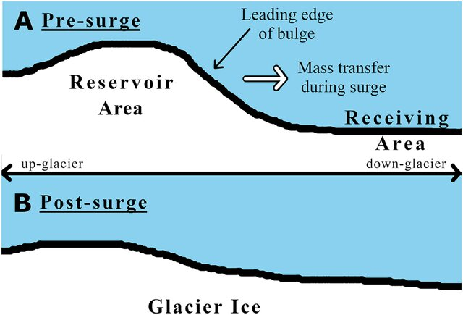
Surging and the critical role of water in surge events
When ice thickness exceeds a threshold, the glacier surges (bed topography)
Rapid motion during the surge changes the efficiency of the hydrological system, switch from EDS to IDS (Kamb 1987)
Occurrence of water in crevasses is indicative of the start of the mature surge phase (Bering Glacier field observations 1993-95, Post, Molnia, Herzfeld, Lingle, Mayer, Roush, and others)
Change from efficient to inefficient drainage system is a transition rather than a switch (Trantow and Herzfeld 2018)
Trantow, Thomas, and Ute C. Herzfeld. “Evolution of a Surge Cycle of the Bering‐Bagley Glacier System From Observations and Numerical Modeling.” Journal of Geophysical Research: Earth Surface 129, no. 1 (January 2024): e2023JF007306. https://doi.org/10.1029/2023JF007306.
Notes:
Surge is an acceleration of a glacier to 10-200 x its normal velocity (NGS is 200, and reached 21 m/d in 2017)
When the thickness of the surge glacier builds a reservoir area, the glacier surges.
Rapid motion during the surge changes the efficiency of the hydrological system. First described in Barclay Kamb 1987 and this is not a switch in Tom’s paper.
The focus of this talk: mapping supraglacial water from imagery and altimetry during the surge of the NGS.

Slide 4
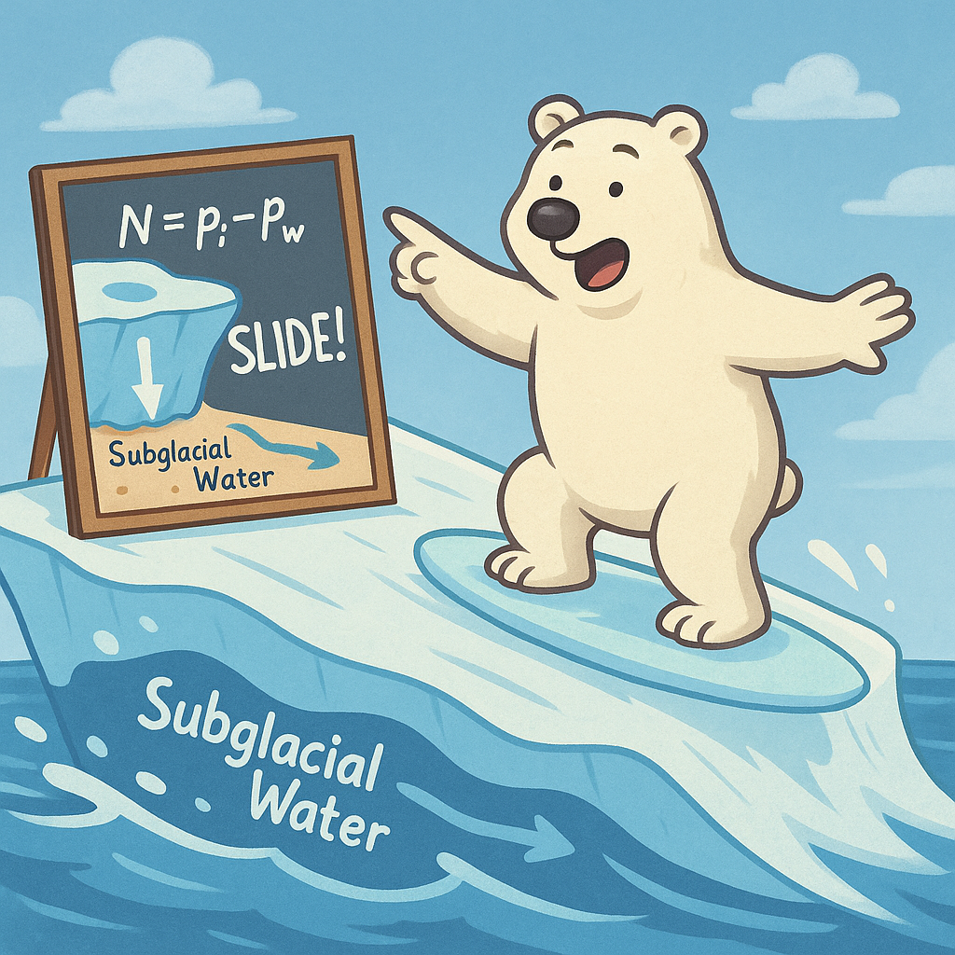
Subglacial water drives glacial acceleration
Reduction of friction at the bed enhances basal sliding:
$$τ_{b}=C_{m}\left(N\right)u_{b}^{\frac{1}{m}}$$ where $τ_{b}$ is basal shear stress, $C_{m}$ is a friction coefficient dependent on the effective pressure, $N$and $u_{b}$ is the basal velocity
Glacial Drainage Systems inform the effective pressure (SHMIP, de Fleurian and others, 2018) $N=p_{i}−p_{w}$
where $p_{i}$ is ice overburden pressure and $p_{w}$ is water pressure
Sources of basal water (pressure, geothermal heating, surface)
Limited understanding of connectivity to the surface
Build on existing theory of effective pressure distribution
How does supraglacial water reflect this theory or change it?
Notes:
To understand surges, we need to understand how water can contribute to glacial acceleration.
Glacial sliding is one of the mechanisms that makes glacial movement possible (other is internal deformation). Glacial sliding is enabled when basal shear stress is low enough for the glacier to slip over its bed.
In models, this is typically implemented with a general power friction law. Describes the influence of velocity and effective pressure, N, on basal shear stress. My knowledge on this has largely come thanks to working a simple basal water model for CISM, in which we test a couple variations of this law, but mostly a simpler one, assuming a steady state velocity, and linear relationship with N. To reduce effective pressure, which is ice overburden and water pressure difference, high basal water pressures are needed. These basal water pressures are able to become high by inefficiencies in the drainage system, which allow for storage of water at the base.
My goal is to make use of more readily available and higher resolution satellite data to contribute to theory of glacial acceleration, and I want to understand how supraglacial water signatures might then reflect changes of the subglacial water drainage system and connectivity to the base.

Slide 5
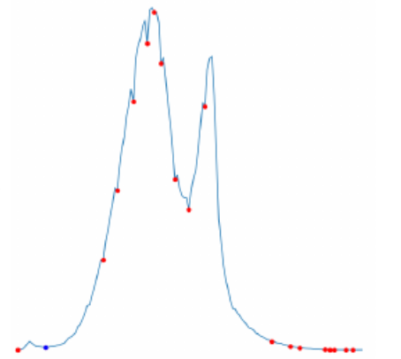
Spectral Classification
Spectral Distribution, Red Edge Band
Use many multispectral images that capture water
Map surface water occurrence
Compare to indicators of acceleration/surge activity
GEOCLASS (Herzfeld 2024, Twickler 2025 in review)
Pixel Count
Reflectance Value

Slide 6
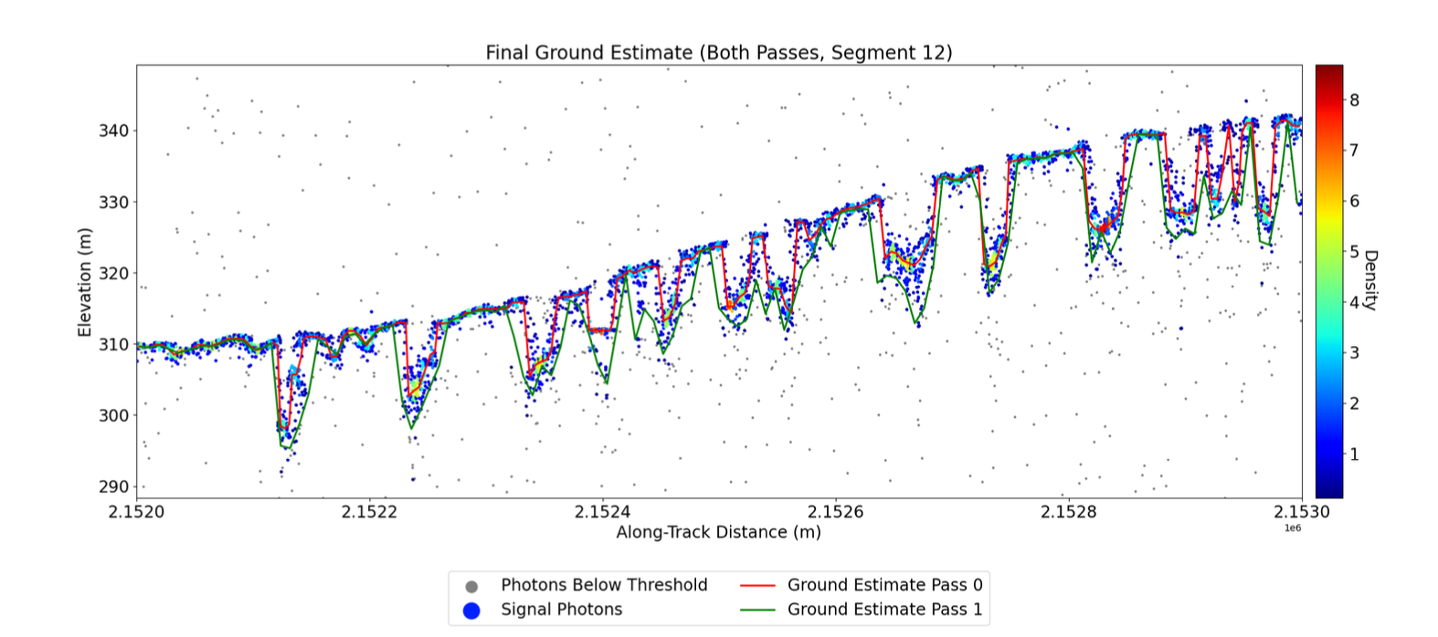
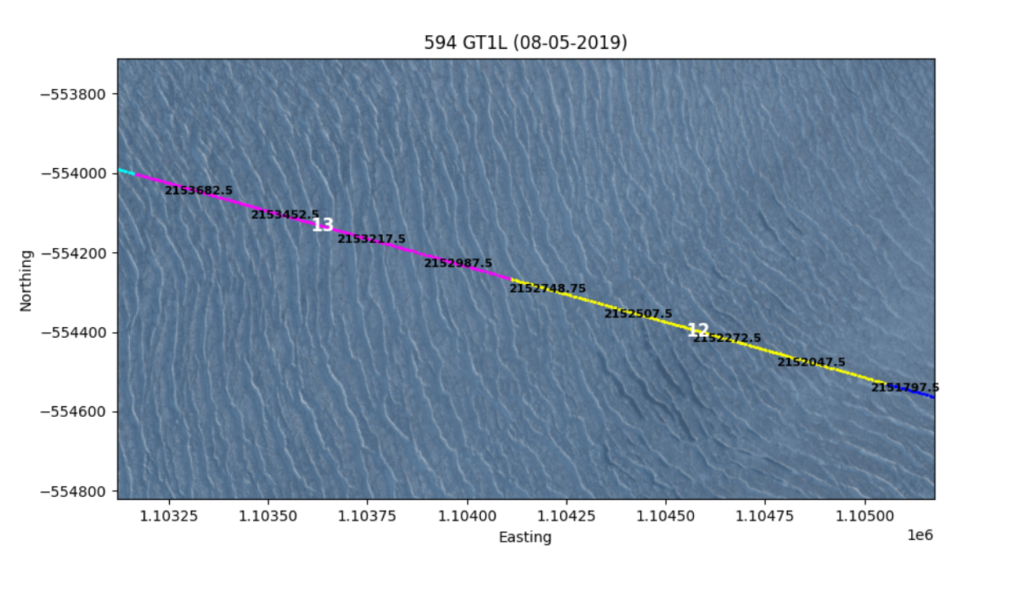
Ice Surface Height Information (DDA-Ice)
Density-Dimension Algorithm for Ice Surfaces
Morphological information (simple crevasse structure)
Crevasse Depth
Approximate volume of water
In water-rich regions, volume/depth analysis is especially important
Herzfeld, U. & Middleton, R, et. al (2024)

Slide 7
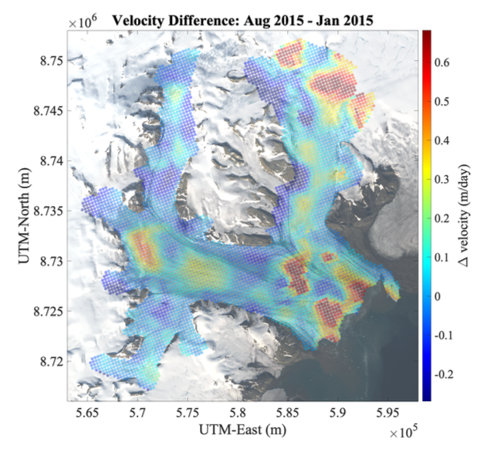
Pre-Surge State
Last surged 1935/36, current surge 2016-current
Limited connectivity to bed
Some ponding in upper crevasse province
Supraglacial runoff
Melt streams and pond(s)
Regions of seasonal acceleration
Upper-crevasse
Middle-crevasse
Chaos- crevasse
Notes:
Negribreen had a ~80yr gap between its last surge and its current one. Prior to its current surge (2015), melt streams and small amounts of ponding reflect limited amounts of connection to the bed, some in the upper crevasse prov. Initial crevassing and acceleration in the lower/chaos crev prov reflects how the glacier is weaker there, and this will be where the surge begins.

Slide 8
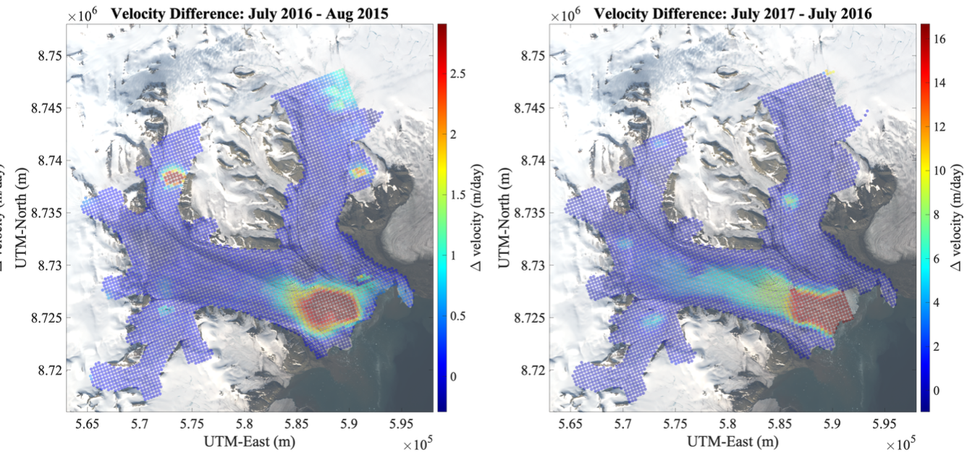
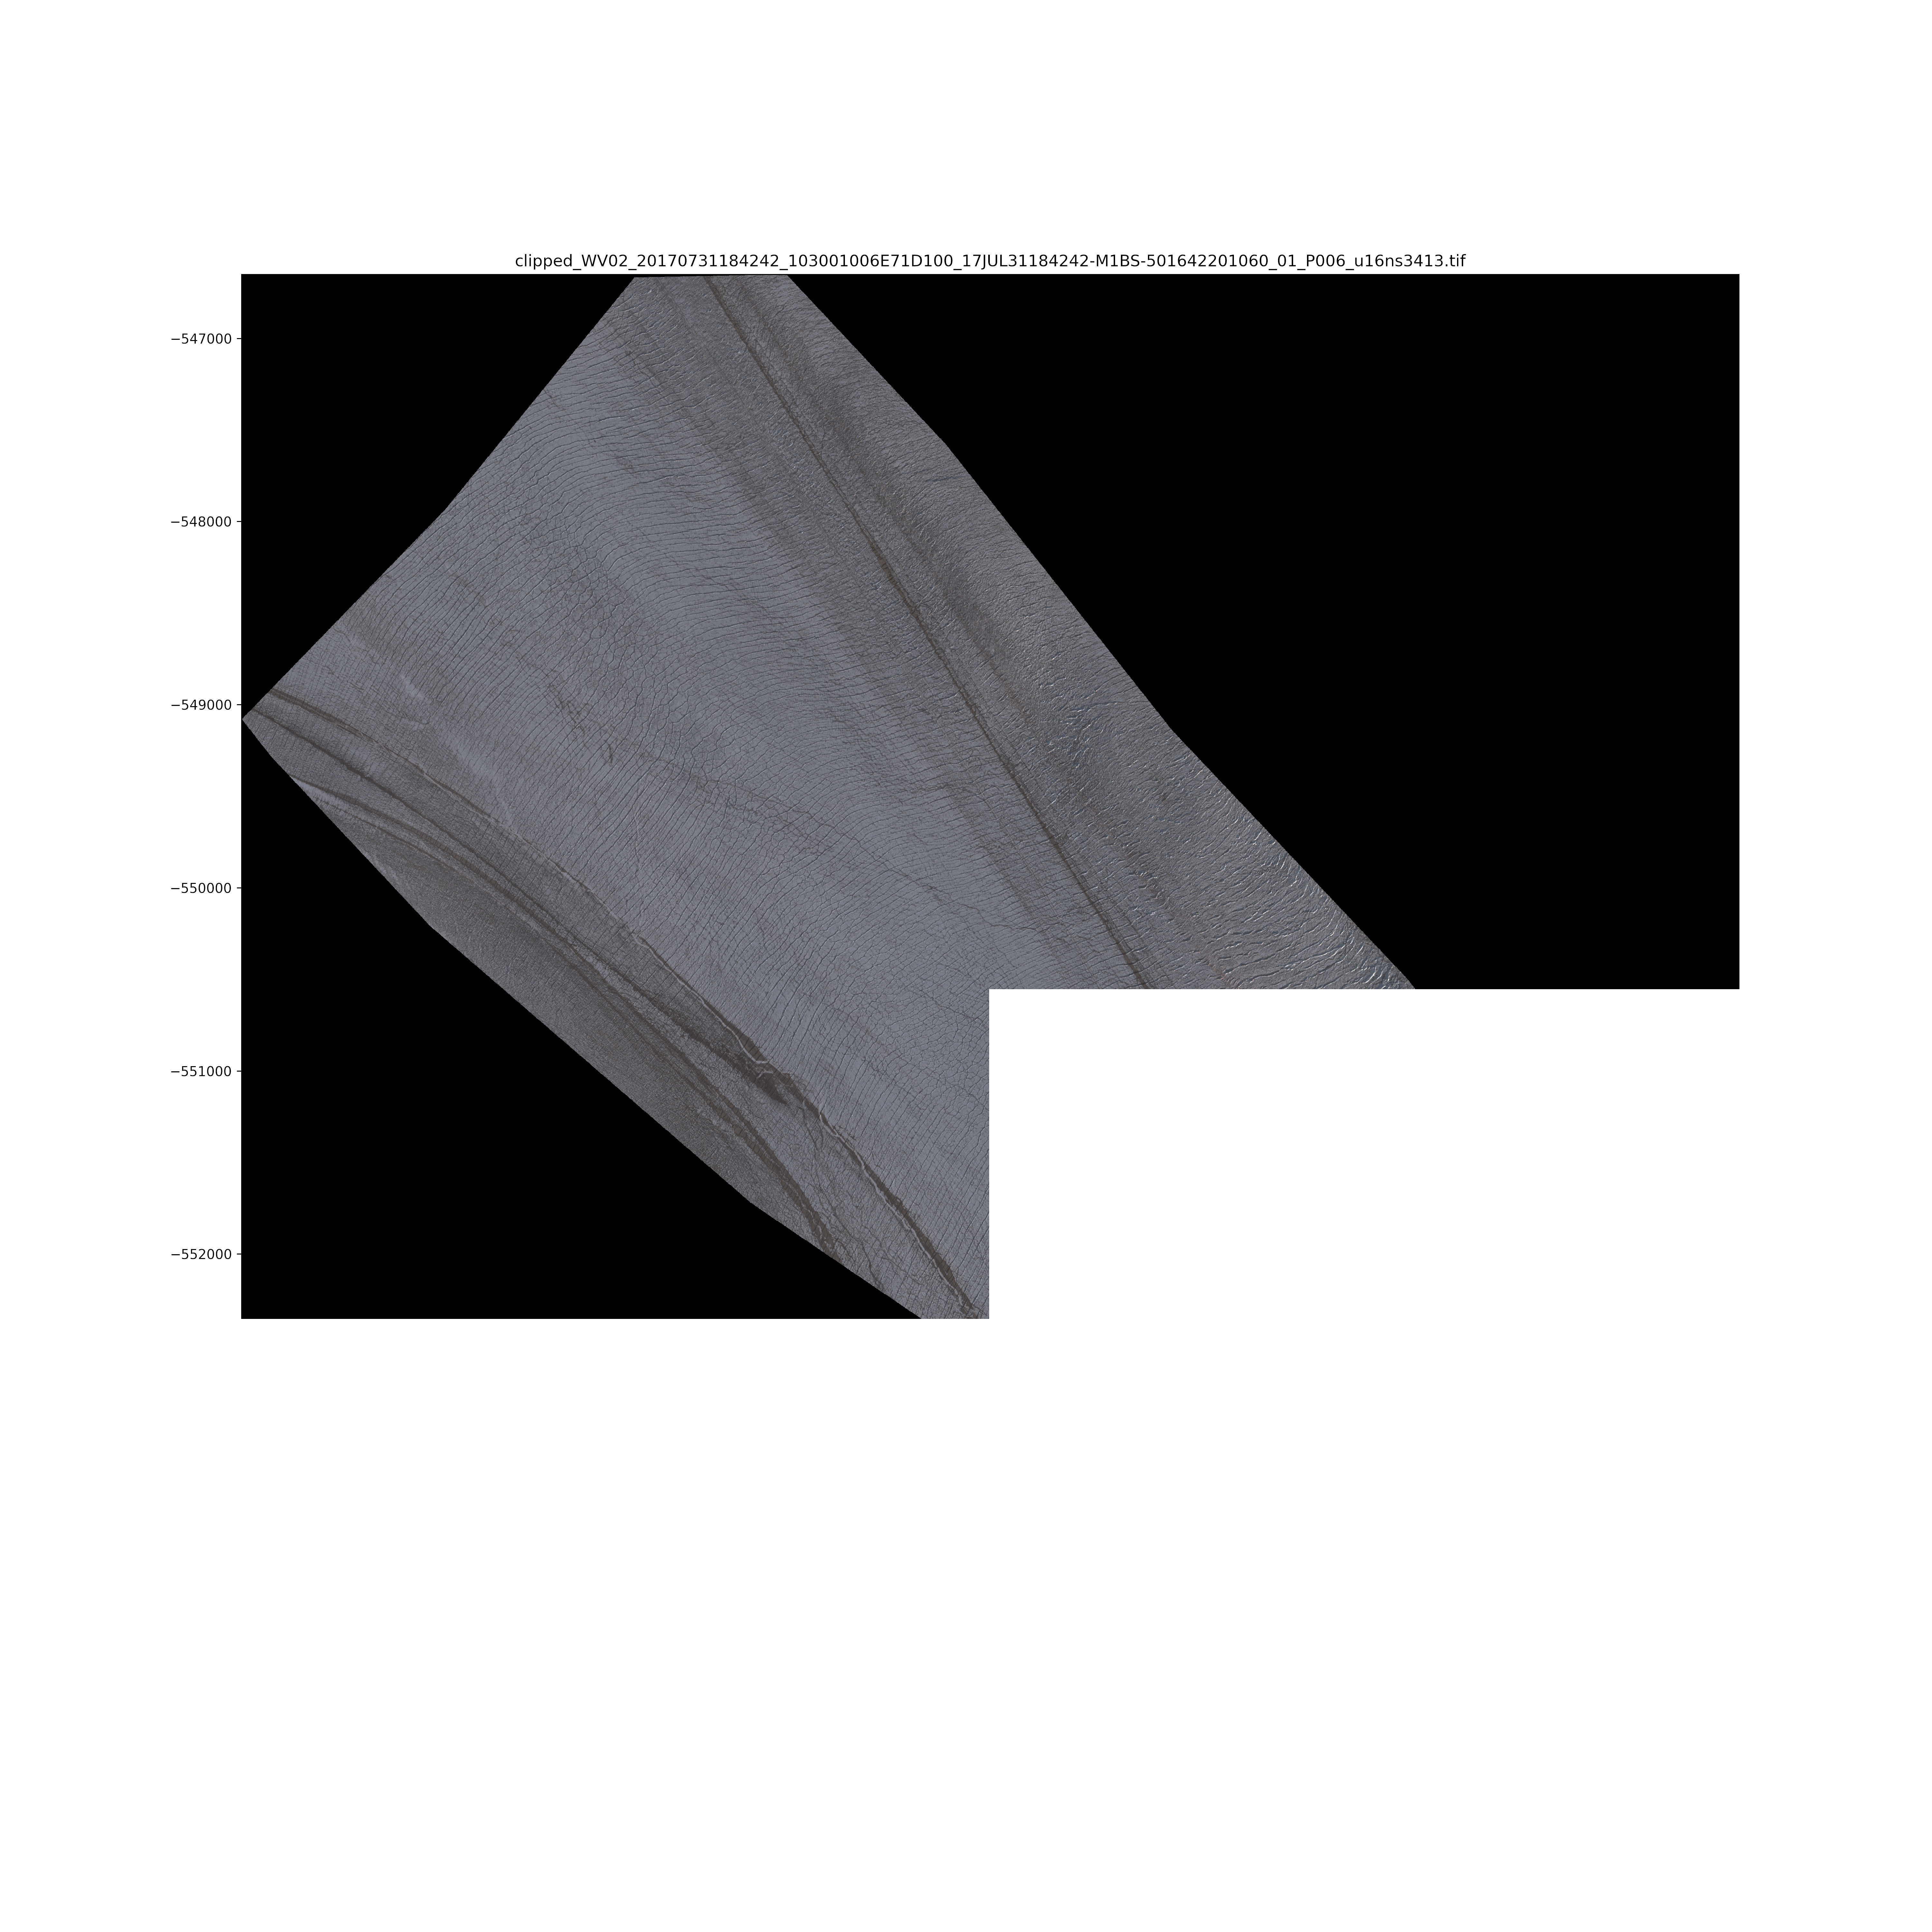
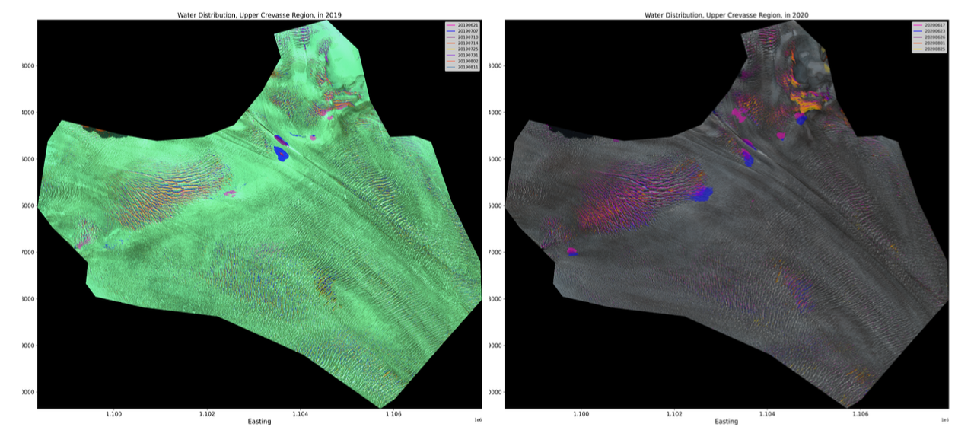
Peak Surge State
Early surge
Little supraglacial water
Acceleration pattern indicates the propagation of the kinematic surge wave (2016-2017)
Water ponding expands in upper crevasse region in subsequent years
Notes:
In 2016-2017, the glacier surges its fastest. During this time the kinematic surge wave propagated from near the glacier front to the upper crevasse province.
Water is not present during this time, but does begin to pond after the surge wave propagated up glacier. As the years go by, ponding in the upper crev becomes more extensive. This reflects a growing inefficient drainage system, which was caused initially by the mechanical disruption of the surge wave.

Slide 9
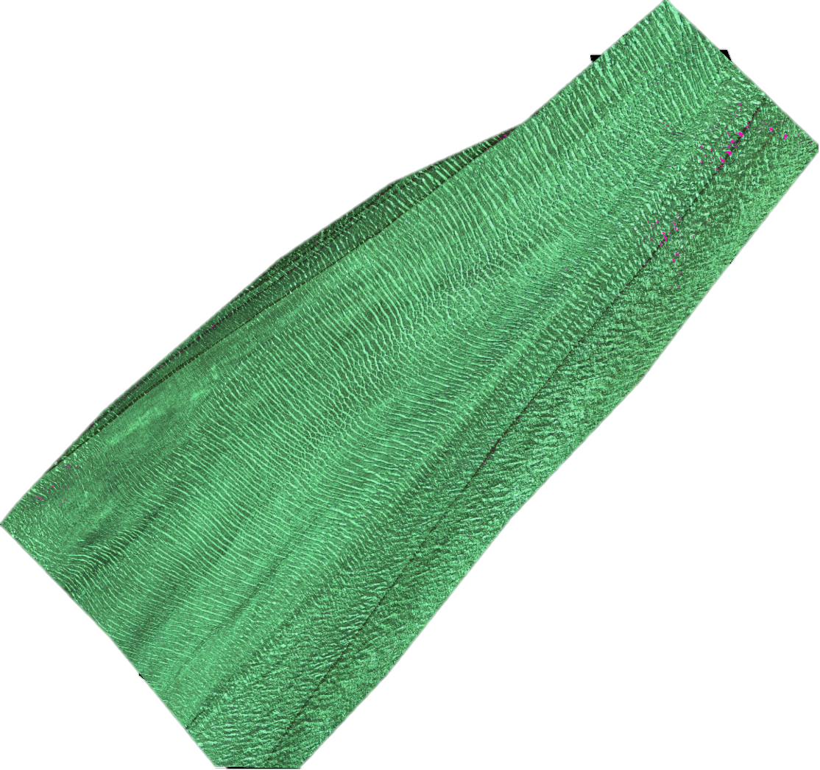
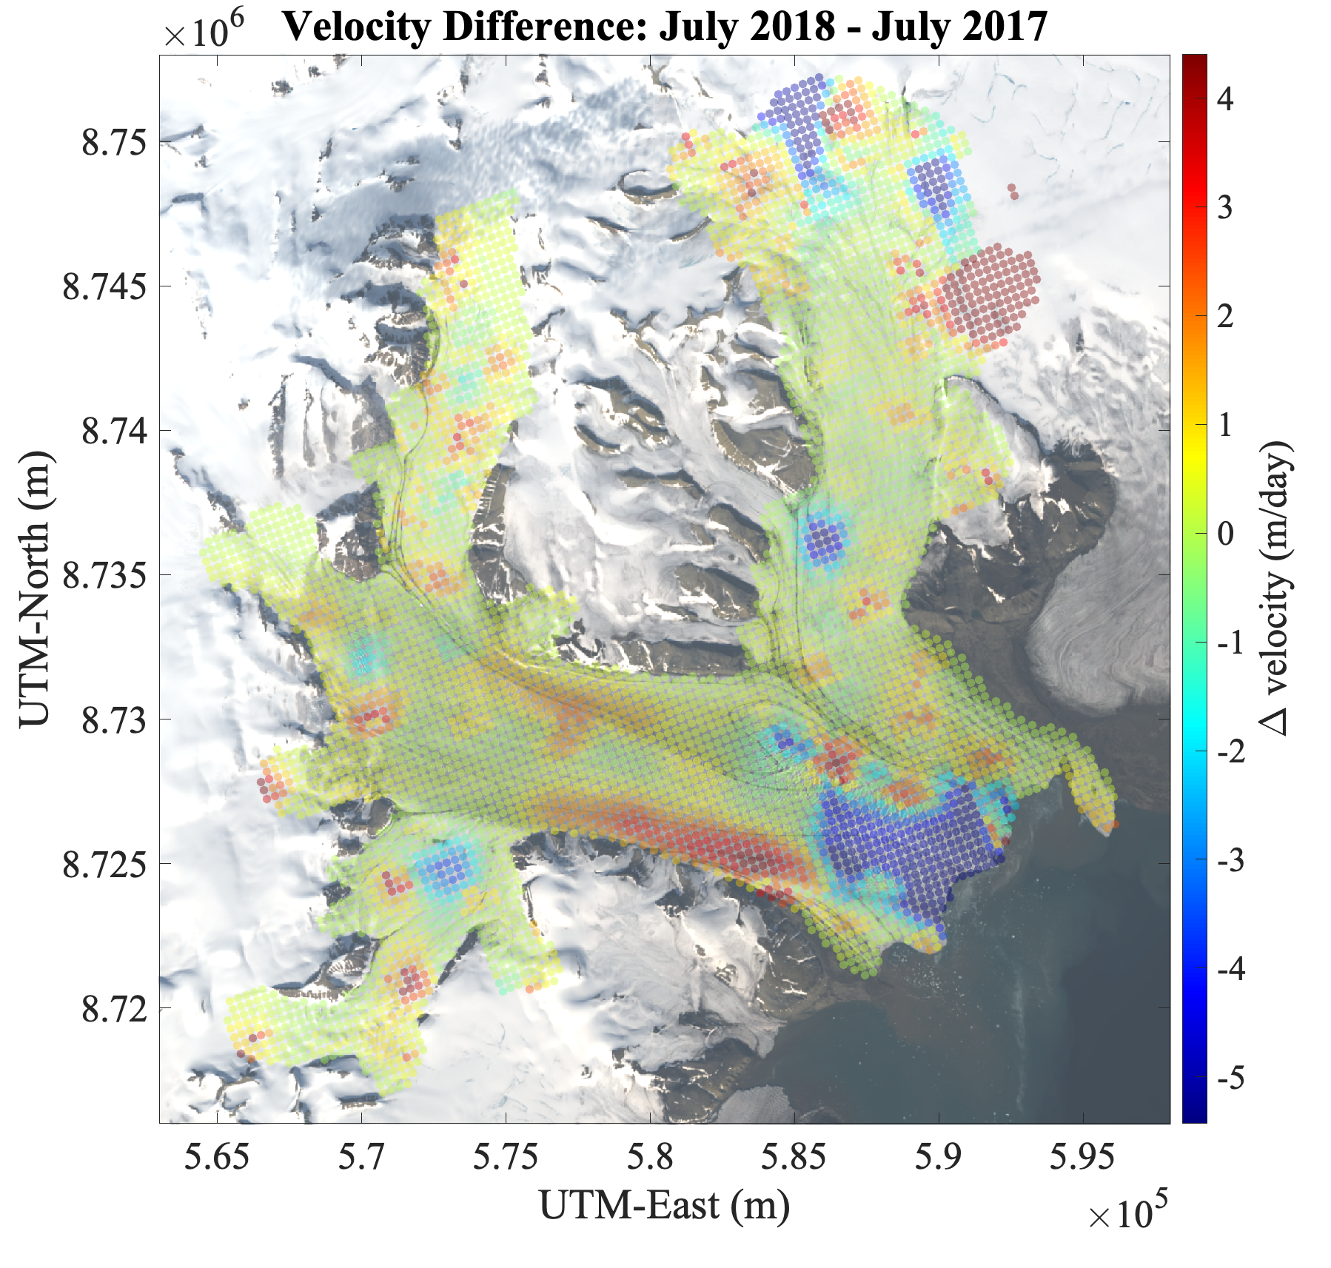
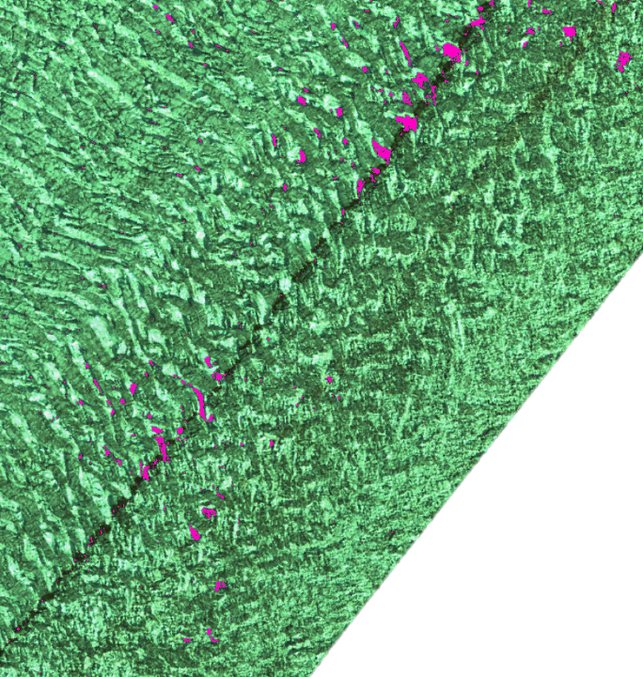
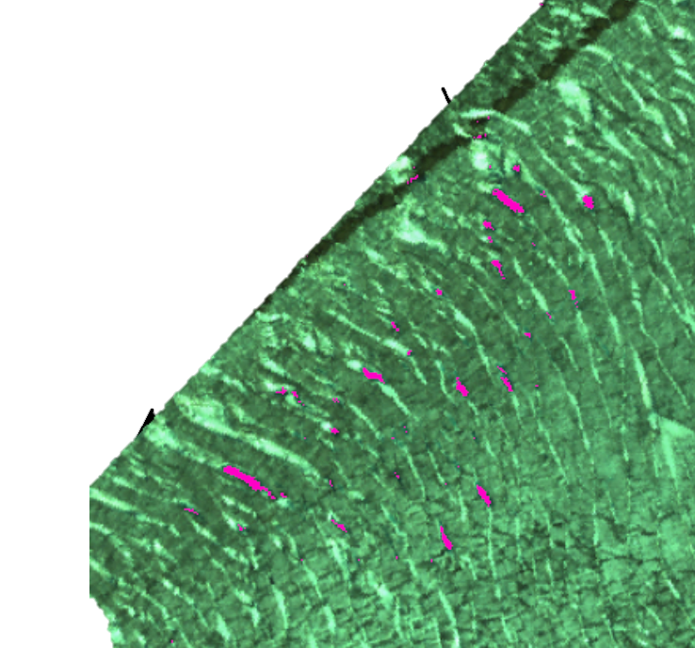
Mature Surge State
Middle Crevasse Region; August 2019
2018-current
Water ponding in the margins occurs at the surface a year after acceleration in the margins
Acceleration patterns and subsequent surface ponding indicate localized drainage system inefficiencies
Warrants future exploration of surface acceleration, basal sliding, and supraglacial water connection
Notes:
In 2018, a noteable acceleration occurs in the lower margin of Negri.
This acceleration is followed (+1 yr) by apparent small ponding features in a region generally close to the margin. Smaller accelerations, local. There is an apparent lagged connection to surface water and accelerations may rely on water supply to the bed in that year.
Most certainly, water sources are nearby but not necessarily completely aligned with velocity. Ponding occurs upstream. This at least warrants future explorations of the relationship between surface acceleration, basal sliding, and supraglacial water.

Slide 10
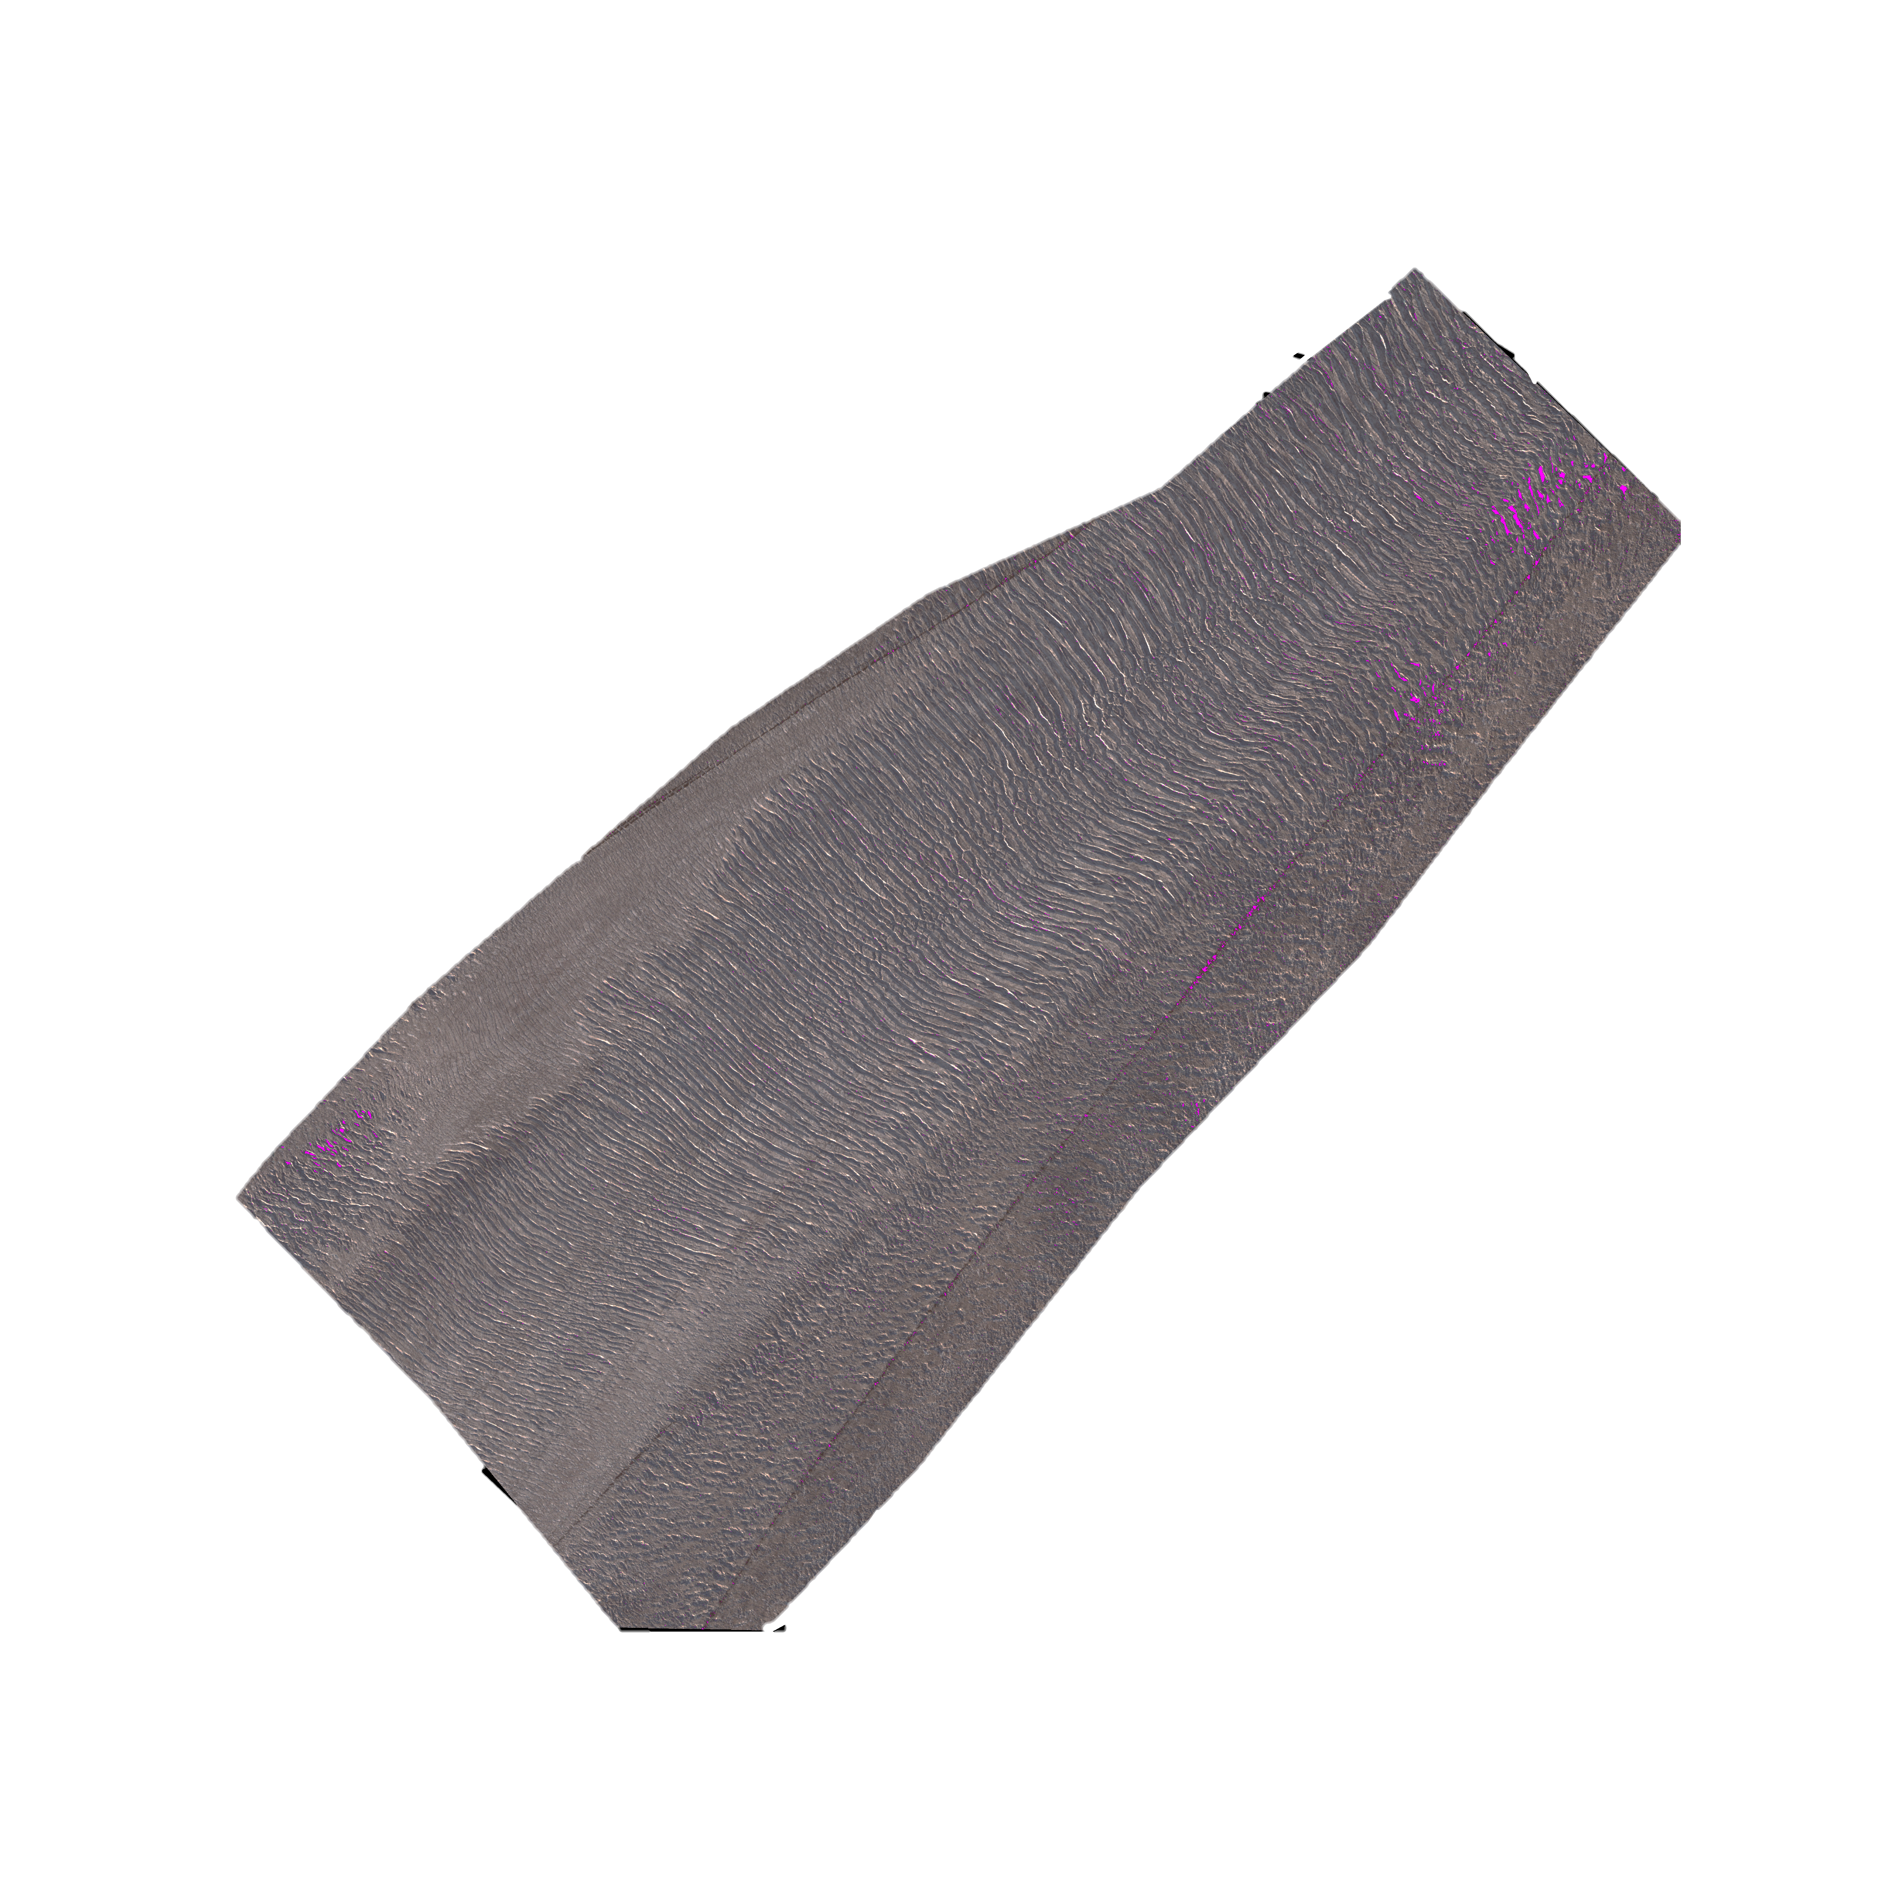
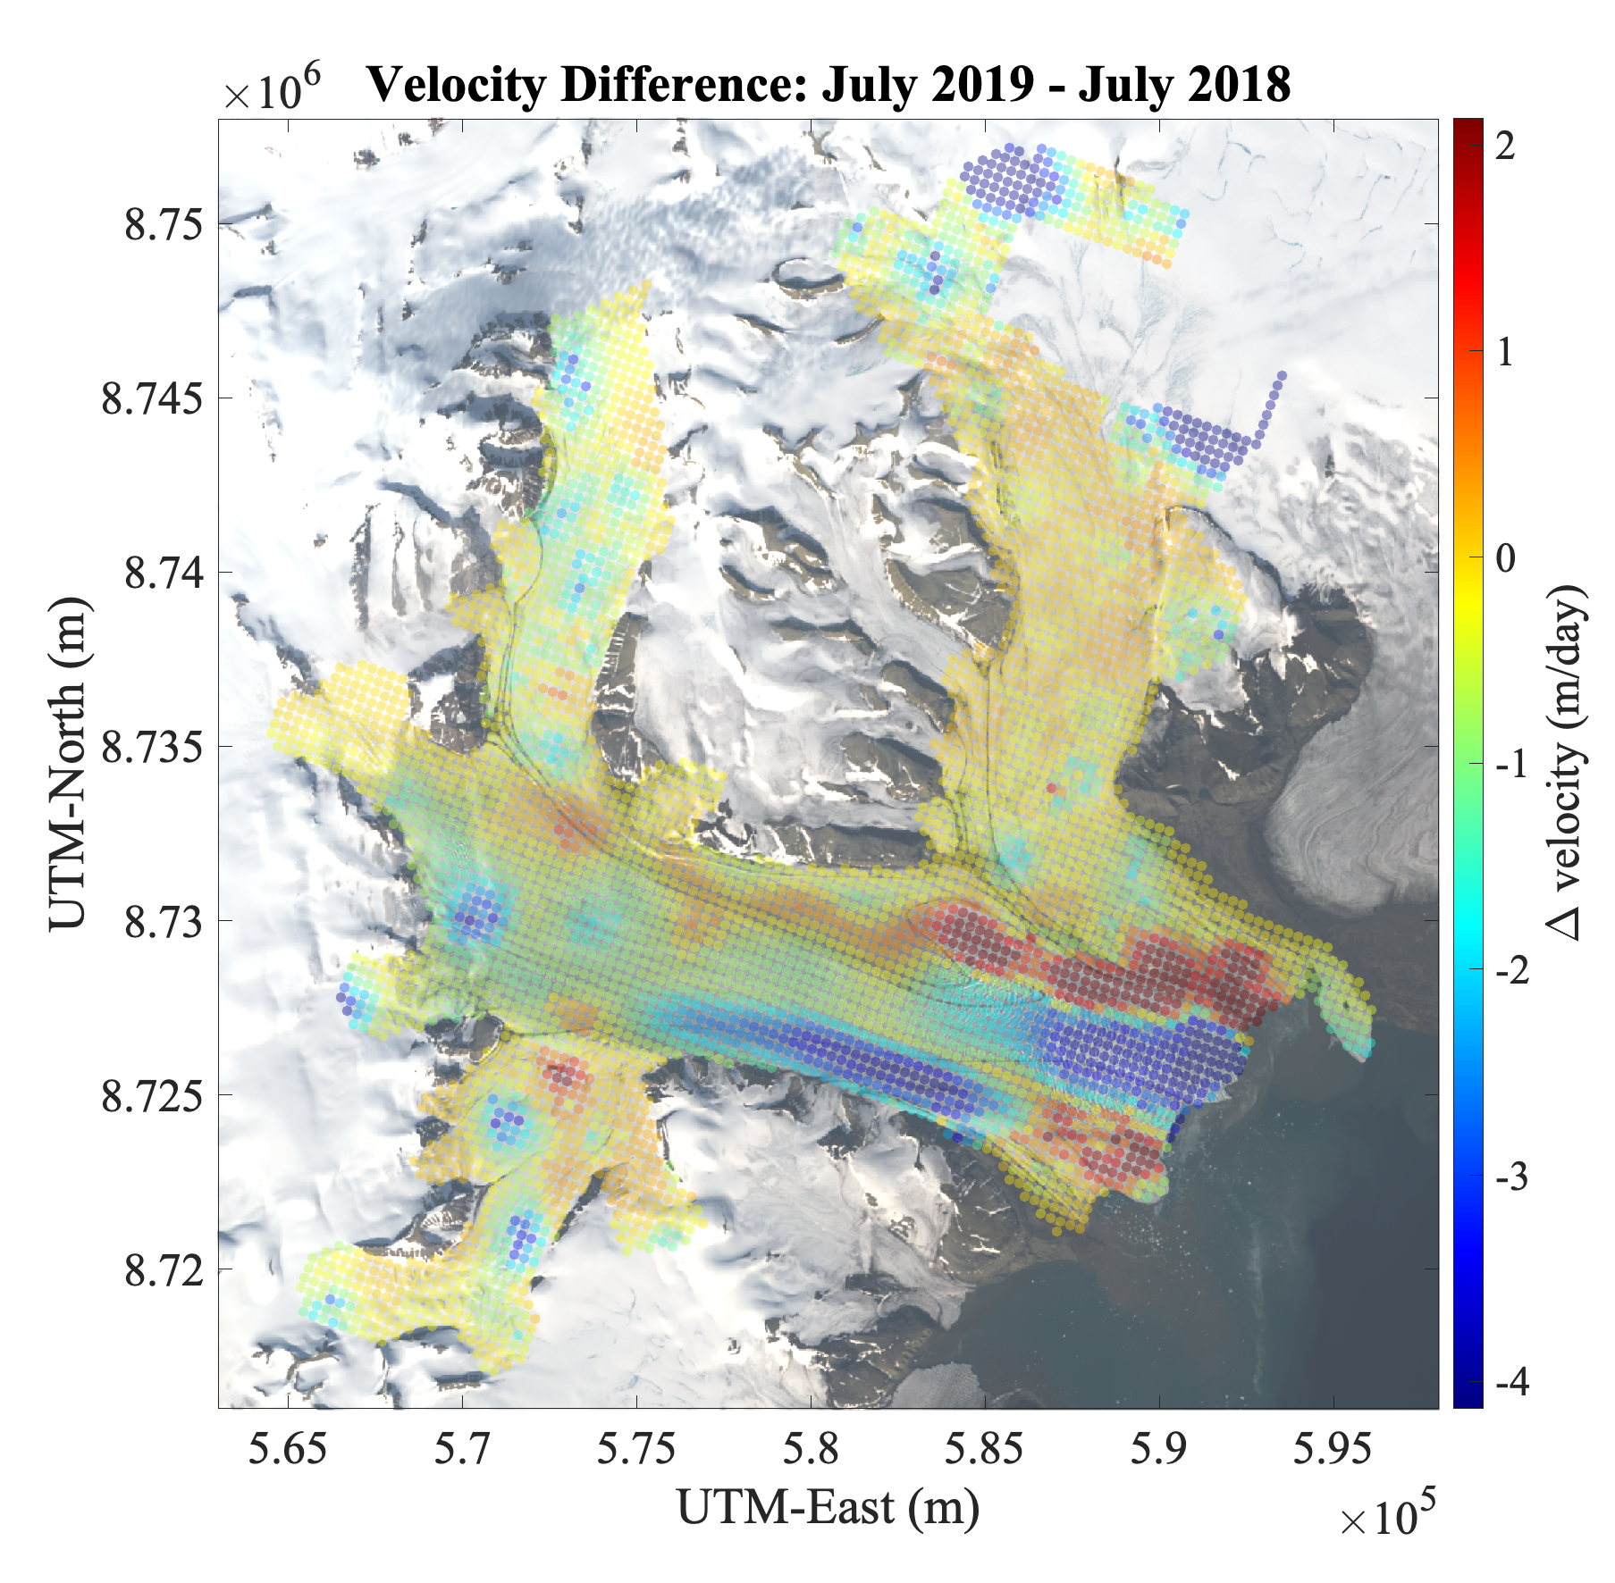
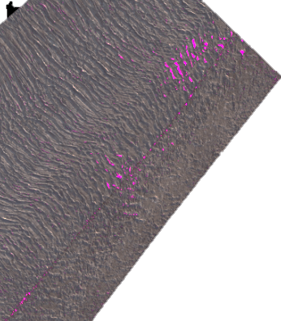
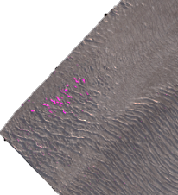
Mature Surge State
Middle Crevasse Region; July 2020
2018-current
Water ponding in the margins occurs at the surface a year after acceleration in the margins
Acceleration patterns and subsequent surface ponding indicate localized drainage system inefficiencies
Warrants future exploration of surface acceleration, basal sliding, and supraglacial water connection
Notes:
A similar phenomena occurs in 2019/2020 in which more extensive ponding occurs in the upper margin ~one year after the acceleration of the upper margin. These accelerations could reflect how the bed becomes uncoupled from the margins, and ponding at the surface suggests that this could be at least partially hydrologically driven.

Slide 11
Conclusions and Future Work
Supraglacial water ponding is a response
Supraglacial water can highlight where water was previously connected to the bed lending credibility to theories of drainage system configuration
Velocity and water can be used together with other signatures to develop a full picture of evolving glacial dynamics with two stages of accelerations
Distinguish between drainage system efficiency and bed surface connectivity
Test magnitude of hydrological inputs, how does it compare to the magnitude of ponded supraglacial water?
Notes:
It’s clear that supraglacial water ponding is a response to accelerations/newly introduced drainage inefficiencies and not an predictor. But, surface ponding could highlight where water was previously connected to the bed, lending credibility to theories of drainage system configuration. It’s clear that water also can have a non-localized response to surge activity, as was the case with ponding in the upper crev region, which certainly reflected downglacier drainage inefficiencies. Differences in timing of water reflect how the drainage system inefficiency can be spatially variable – having some efficient and inefficient drainage. In the future, I hope to explore how the magnitude of water ponded on the surface, and its potential connections to the bed, could drive acceleration at the base, which could then result in a ponding response. Take a more quantitative approach and also consider other dynamic signatures (crevassing, changes in surface gradient).

Slide 12
References
Middleton, R., Herzfeld, U., Trantow, T. (in prep), The Supraglacial Hydrologic Response to Surge Dynamics - Insights from WorldView Imagery and ICESat-2 LiDAR during the Surge of the Negribreen Glacier System Herzfeld, U., Middleton, R., Trantow, T., Hayes, A. (subm. 2024), Water in Ice – It’s Detection, Measurement and Role in Understanding Glacial Acceleration and Melt Processes from ICESat-2 Altimeter Data, J. Geophys. Res. doi:10.22541/essoar.173524501.13997622/v1.
GEOCLASS-image -- A Versatile Machine Learning Environment for Ice-Surface Classification from High-Resolution Image Data (subm. 2025), Computers and Geosciences. Doi: 10.22541/essoar.173924078.85494569/v1
DE FLEURIAN B, WERDER MA, BEYER S, et al. SHMIP The subglacial hydrology model intercomparison Project. Journal of Glaciology. 2018;64(248):897-916. doi:10.1017/jog.2018.78 Sevestre, H., D. I. Benn, N. R. J. Hulton, and K. Bælum (2015), Thermal structure of Svalbard glaciers and implications for thermal switch models of glacier surging, J. Geophys. Res. Earth Surf., 120, 2220–2236, doi:10.1002/2015JF003517. Sevestre, Heïdi & Benn, Douglas. (2015). Climatic and geometric controls on the global distribution of surge-type glaciers: Implications for a unifying model of surging. Journal of Glaciology. 61. 646-662. 10.3189/2015JoG14J136. U. Herzfeld, T. Trantow, B. McDonald, and M. Stachura. Crevasses, supraglacial water and basal hydropotential as indicators of surge progression in the Bering Bagley Glacier System, Alaska (2011-2013). Annals/Journal of Glaciology, 57(72).
U. C. Herzfeld, B. McDonald, M. Stachura, R. G. Hale, P. Chen, and T. Trantow. Bering Glacier surge 2011: Analysis of laser altimeter data. Annals of Glaciology, 54(63):158–170, 2013.
Ute Herzfeld, Thomas Trantow, Ellen Buckley, Sin ́ead Farrell, and Matthew Lawson. Automated detection and depth measurement of melt ponds on sea ice from ICESat-2 ATLAS data — the DDA-bifurcate-seaice. IEEE Transactions of Geoscience and Remote Sensing, pages 1–16, 2023. pub- lished April 18, 2023.
Ute Herzfeld, Thomas Trantow, Matthew Lawson, Jacob Hans, and Gavin Medley. Surface heights and crevasse types of surging and fast-moving glaciers from ICESat-2 laser altimeter data — Application of the density- dimension algorithm (DDA-ice) and validation using airborne altimeter and Planet SkySat data. Science of Remote Sensing, 3:1–20, 2021.
W. B. Kamb. Glacier Surge Mechanism Based on Linked Cavity Con- figuration of the Basal Water Conduit System. Journal Geophys. Res., 92(B9):9083–9100, 1987.
H. Mayer and U.C. Herzfeld. Structural glaciology of the fast-moving Jakobshavn Isbræ, Greenland, compared to the surging Bering Glacier, Alaska, USA. Annals of Glaciology, 30(1):243–249, 2000.
B. Molnia and A. Post. Holocene history of Bering Glacier, Alaska: a prelude to the 1993-1994 surge. Physical Geography, 16(2):87–117, 1995.
T. Trantow and U. Herzfeld. Spatiotemporal mapping of a large mountain glacier from CryoSat-2 altimeter data: surface elevation and elevation change of Bering Glacier during surge (2011-2014). International Journal of Remote Sensing, 36:2962 –2989, 2016. Gao, Bo-cai. “NDWI—A Normalized Difference Water Index for Remote Sensing of Vegetation Liquid Water from Space.” Remote Sensing of Environment 58, no. 3 (December 1996): 257–66. https://doi.org/10.1016/S0034-4257(96)00067-3. Watson, C. Scott, Owen King, Evan S. Miles, and Duncan J. Quincey. “Optimising NDWI Supraglacial Pond Classification on Himalayan Debris-Covered Glaciers.” Remote Sensing of Environment 217 (November 2018): 414–25. https://doi.org/10.1016/j.rse.2018.08.020.
Zhao, Yi, Xinchang Zhang, Weiming Feng, and Jianhui Xu. “Deep Learning Classification by ResNet-18 Based on the Real Spectral Dataset from Multispectral Remote Sensing Images.” Remote Sensing 14, no. 19 (September 30, 2022): 4883. https://doi.org/10.3390/rs14194883.

