Slide 1
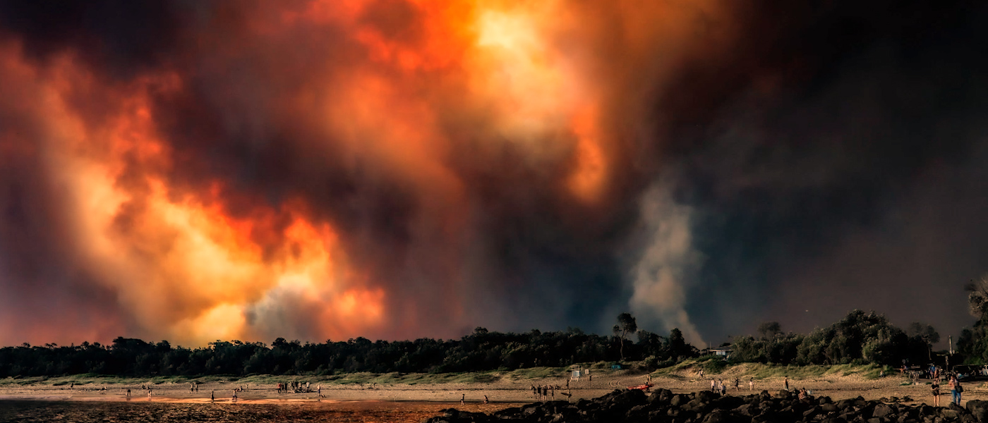





Model-measurement comparisons during Australian extreme bushfires: MUSICA and AQFx
Master of Philosophy (MPhil)
Samantha Lee¹,
Supervisors: Clare Murphy², Jason Evans¹, Tim Raupach¹
1. University of New South Wales, 2. University of Wollongong,

Slide 2
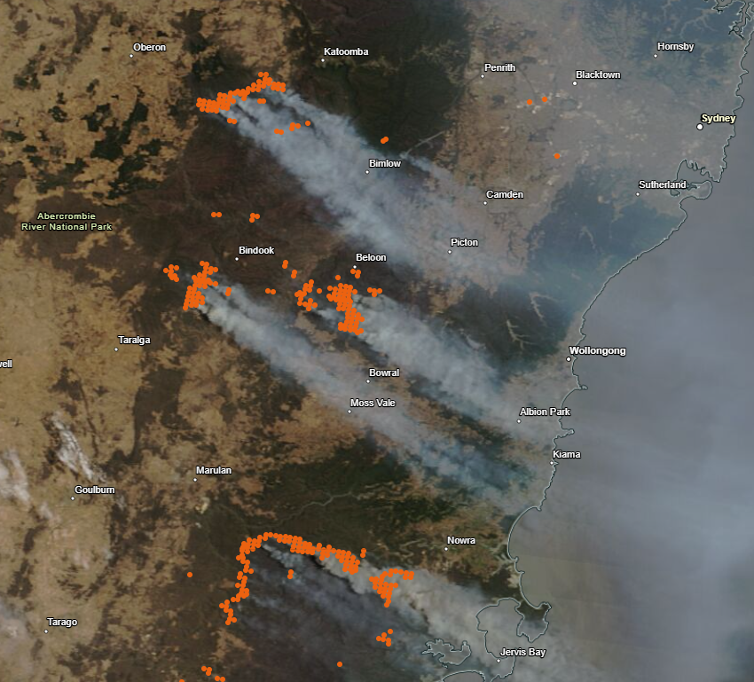
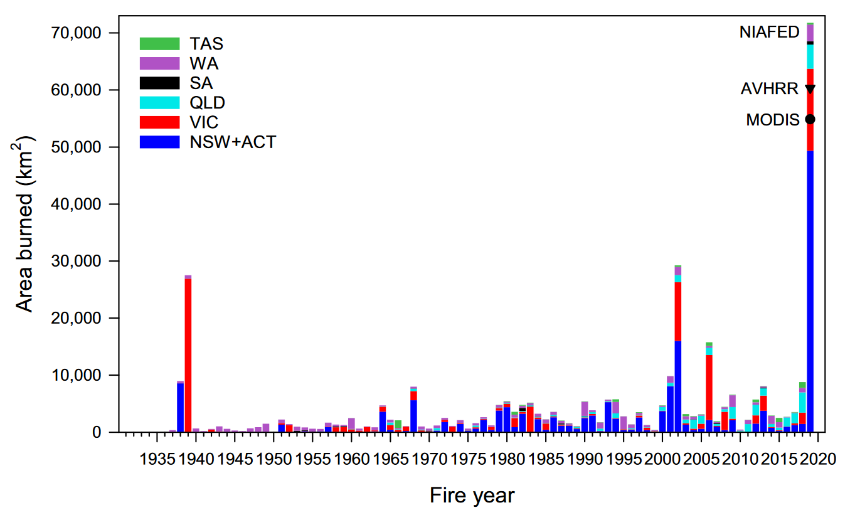
The Context
In 2019 – 2020, south-east Australia faced one of the worst bushfire seasons in its recorded history:
Area burnt: 10.2 million hectares
Fatalities: 33
Buildings lost: 31,000 homes
Satellites estimates of forest area burnt in Australia
Imagery provided by services from NASA's Global Imagery Browse Services (GIBS), part of NASA's Earth Science Data and Information System (ESDIS).
Canadell et al., 2021

Slide 3
The Context
In 2019 – 2020, south-east Australia faced one of the worst bushfire seasons in its recorded history:
Area burnt: 10.2 million hectares
Fatalities: 33
Buildings lost: 31,000 homes
The Characterizing Organics and Aerosol Loading over Australia (COALA-2020) campaign measured atmospheric chemistry emissions from December 2019 to March 2020.
Most comprehensive smoke dataset for the region
Imagery provided by services from NASA's Global Imagery Browse Services (GIBS), part of NASA's Earth Science Data and Information System (ESDIS).
Notes:
Fire events are really hard to project in climate models, Current trajectory indicates conditions which increase the frequency and intensity of bushfires like this could increase under climate change

Slide 4
Motivation
Reliable Modelling of Atmospheric Emissions
Future Climate Research
Emission Studies
Air Quality Management
Dissemination of Public Health Advice
Notes:
There is an opportunity to compare the measurement of COALA to the outputs of some select atmospheric chemistry climate models and determine how well they projected the conditions surrounding this extreme smoke event.
This will help us understand how reliable they are for use for future climate research, emissions studies, air quality management and dissemination of public health advice

Slide 5
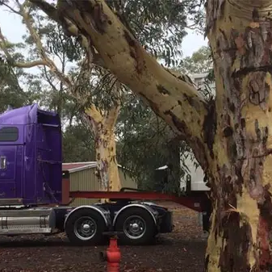
Aims
Compare COALA-2020 measurements to the output of three atmospheric chemistry climate models
Determine how well they reproduce the chemical species concentrations in smoke plumes from extreme bushfires.
Present the results of the overall effectiveness of each model for each chemical species particular to the Australian context.

Slide 6
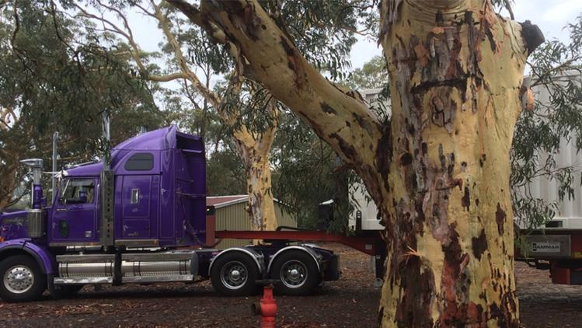
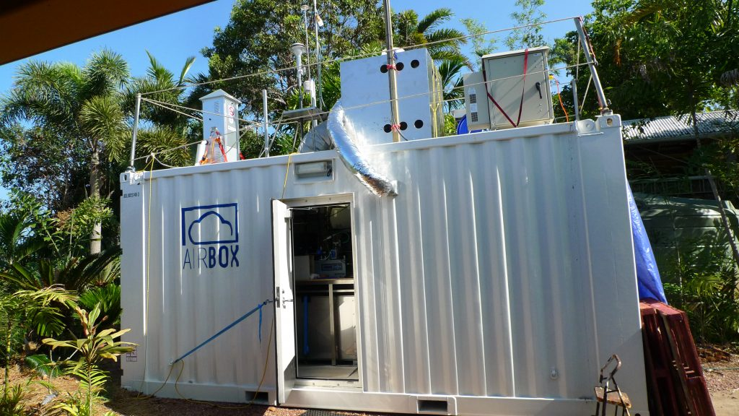
COALA-2020 Measurement Data
Chemical Species measurements occurring from December 2019 to March 2020
Instruments Deployed in the AIRBOX:
PTR-ToF-MS
FTIR
3D sonic anemometer
AQMS (NSW DCCEEW)
Multi-angle absorption photometer
Notes:
Held up by the 2020 eruption of the Taal Volcano

Slide 7
Instruments and Measured Species in COALA- 2020
PRT-TOF-MS | FTIR | Three-dimensional sonic anemometer | AQMS | Multi-angle absorption photometer
Methanol | Carbon dioxide | Wind speed | Humidity, relative | Black carbon, aerosol
Acetonitrile | Methane | Wind speed, maximum | Temperature, air | Aerosol absorption coefficient
Acetaldehyde | Carbon monoxide | Wind direction | Visibility, NEPH
Prop-2-enal | Nitrous oxide |  | Particulate matter, < 2.5 µm
Acetone | carbon dioxide |  | Particulate matter, < 10 µm
Isoprene |  |  | Ozone
Methacrolein + methyl vinyl ketone |  |  | Nitric oxide
Butan-2-one |  |  | Nitrogen dioxide
Benzene |  |  | Nitrogen oxides
Toluene |  |  | Sulfur dioxide
Sum C8H10 (Xylene) |  |  | HEIGHT above ground
Sum C9H12 |  |  | Wind speed
Monoterpenes |  |  | Wind direction
+ more |  |  | Wind direction, standard deviation

Slide 8



Chemical Species of Interest
Human Health Impact | Contributing to Atmospheric Reactions | Greenhouse Gas
Acetaldehyde | Isoprene | Methane
Carbon monoxide | Formic acid
Nitrogen dioxide | Nitric oxide
Sulfur dioxide
Ozone
Methanol
PM2.5
PM10

Slide 9


The Models - AQFx
A regional atmospheric model that was developed as a tool to provide guidance to fire and land management agencies in Victoria for the minimization of population exposure to smoke from planned burns
Resolution
Regional Australian Model
Inventories used:
State EPA inventories
Fuel layer map from AFDRS
EF derived from Pyrotron and FTIR experiments
Weather Modelling
Bureau of Meteorology ACCESS model
24h forecasts at 12:00
9km x 9 km resolution
Average hourly concentrations
Model Data provided by Julie Noonan at the CSIRO, Australia
Notes:
Replace and extend WACCM, CAM-Chem, WRF-CHEM
WRF-CMAQ used satellite of area burned and reports
AQFx uses hotspot as well as reports from ground
MUSICA uses satellite data and the FINN emissions inventory

Slide 10
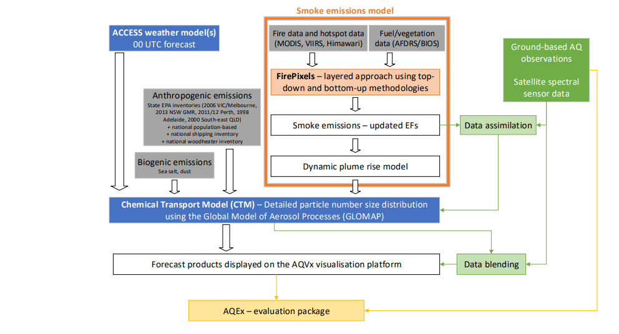
Reisen, F et al, 2024

Slide 11

The Models – CESM MUSICA
The Multi-Scale Infrastructure for Chemistry and Aerosols model, under development at NSF NCAR for simulating of large-scale atmospheric phenomena, while resolving chemistry at emission and exposure relevant scales.
Resolution
Global model with regional refinement capability
Inventories used:
QFED CO2 x FINN emission ratios for fire
CAMS-GLOB-ANT version 5.1
MEGAN 2.1
Dust by Leung et al 2024 scheme
Weather Modelling
Meteorology is nudged towards MERRA2 reanalysis
100 km x 100 km resolution
Average hourly concentrations
Model Data provided by Rebecca Buchholz at NSF National Center for Atmospheric Research
https://www2.acom.ucar.edu/sections/multi-scale-infrastructure-chemistry-modeling-musica
Notes:
Replace and extend WACCM, CAM-Chem, WRF-CHEM
WRF-CMAQ used satellite of area burned and reports
AQFx uses hotspot as well as reports from ground
MUSICA uses satellite data and the FINN emissions inventory

Slide 12
Preliminary Results
Ozone measured in COALA-2020 compared to the outputs of AQFx and MUSICA models

Slide 13
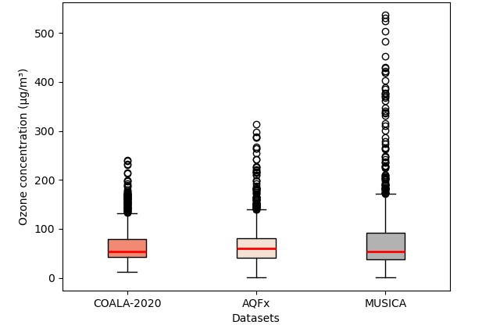
Boxplot for Ozone

Slide 14
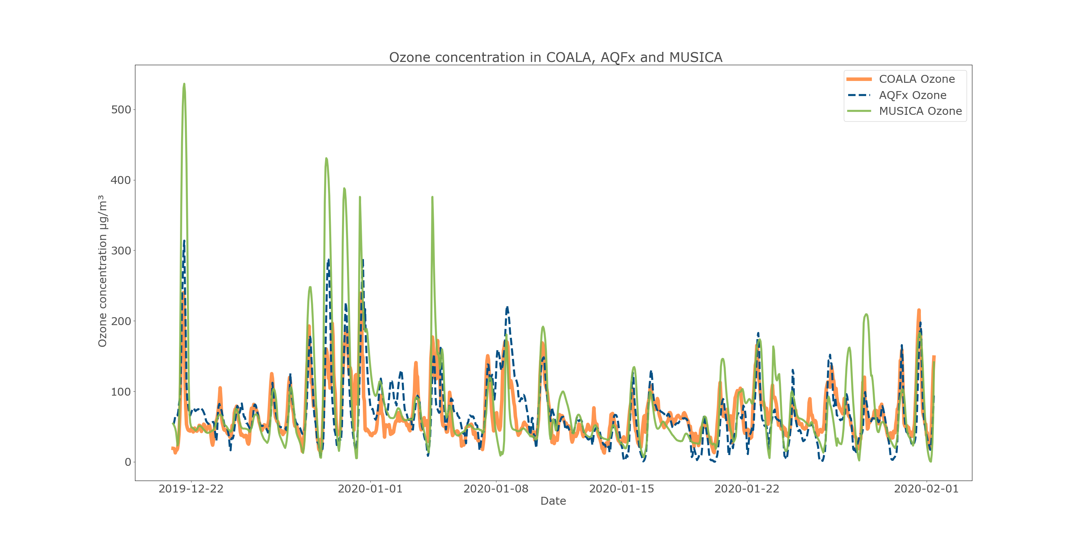
Quantitative Comparison of Ozone

Slide 15
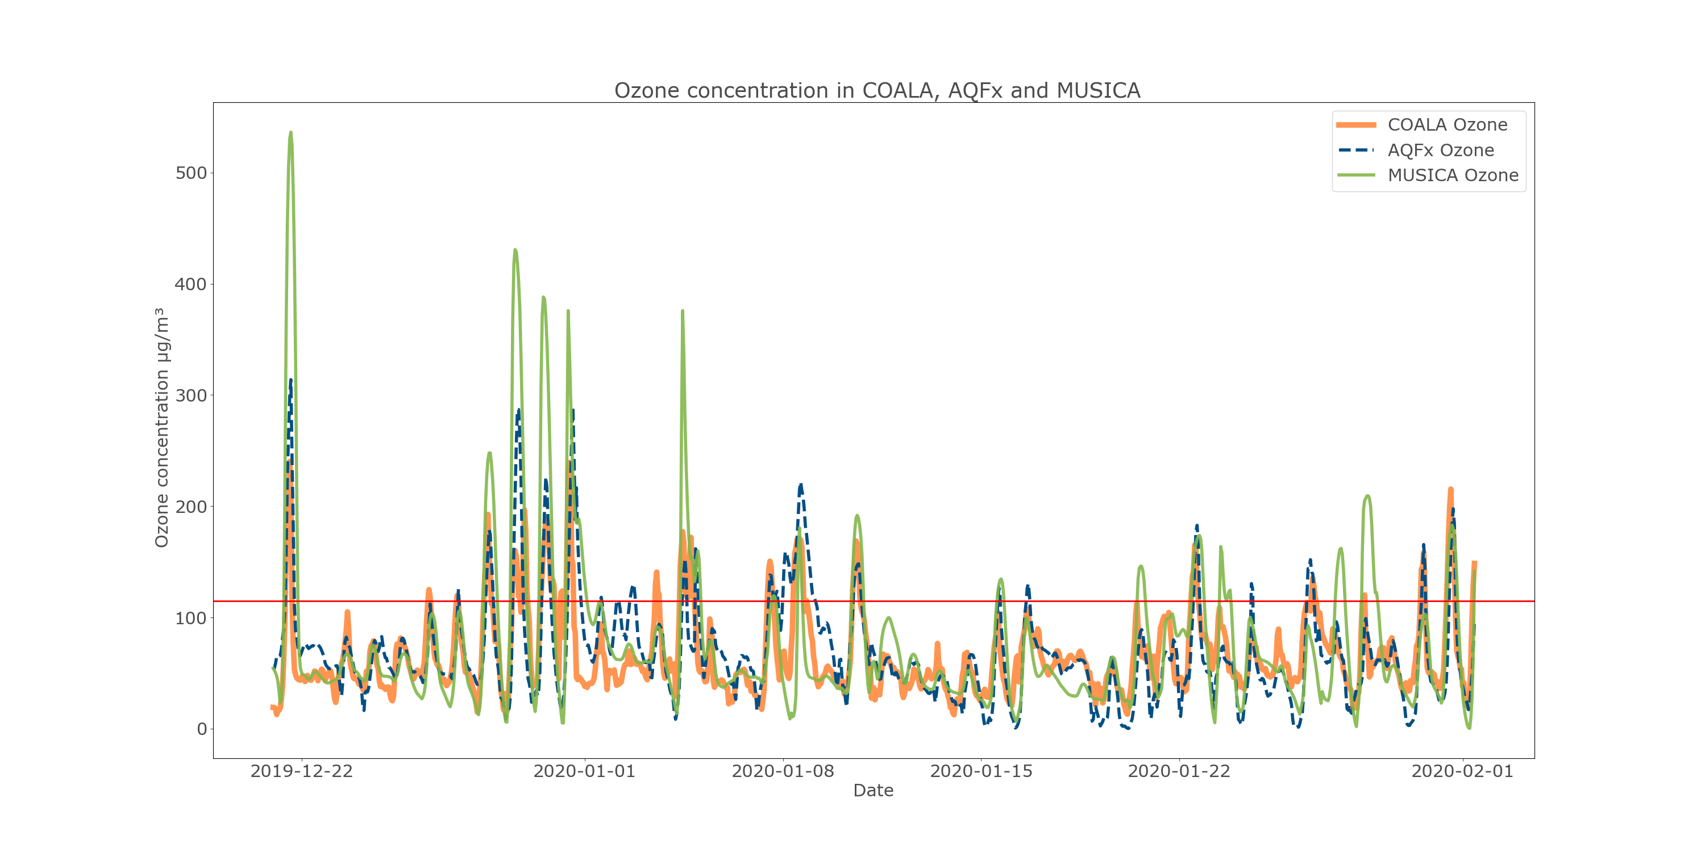
Quantitative Comparison of Ozone
Regulatory exceedance level 115 µg/m³

Slide 16
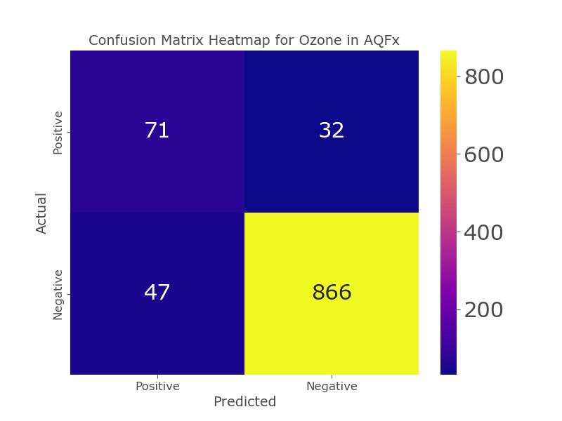
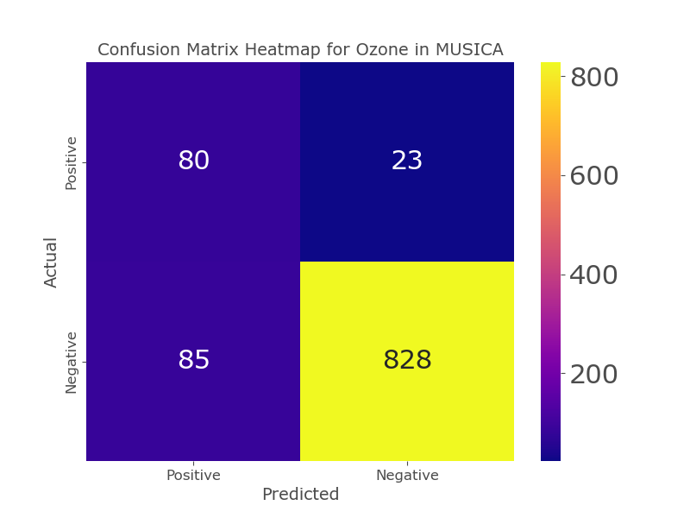
Exceedance Criteria of Ozone
True Positive
False Negative
True Positive
False Negative
False Positive
True Negative
False Positive
True Negative
Green shading indicates where the model was correct
Red shading indicates where the model was incorrect

Slide 17
Exceedance Criteria of Ozone
True Positive
False Negative
True Positive
False Negative
Highly unbalanced, which skews some metrics
False Positive
True Negative
False Positive
True Negative
Green shading indicates where the model was correct
Red shading indicates where the model was incorrect

Slide 18



Exceedance Criteria of Ozone
Accuracy
How often are the model predictions correct?
= (True Positive + True Negatives) / Total Predictions
Precision
How often is a positive prediction correct?
= True Positives / (True Positives + False Positives)
Recall
How many of the true positive instances does the model successfully capture?
= True Positives / (True Positives + False Negatives)
F1-score
Harmonic mean of precision and recall.
= 2 x (Precision x Recall) / (Precision + Recall)

Slide 19
Exceedance Criteria of Ozone
Metric | AQFx | MUSICA
Accuracy | 0.92 | 0.89
Precision | 0.60 | 0.48
Recall | 0.69 | 0.78
F1 Score | 0.64 | 0.60

Slide 20
Preliminary Results
PM 2.5 measured in COALA-2020 compared to the outputs of AQFx and MUSICA models

Slide 21
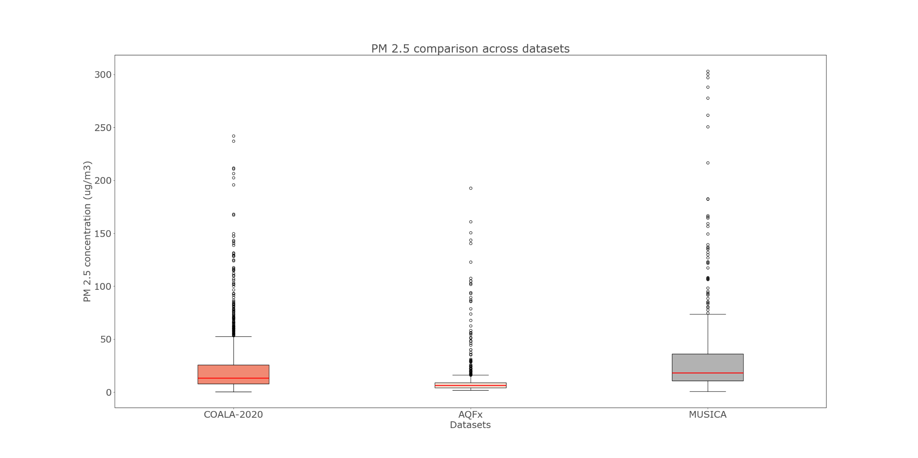
Boxplot for PM 2.5

Slide 22
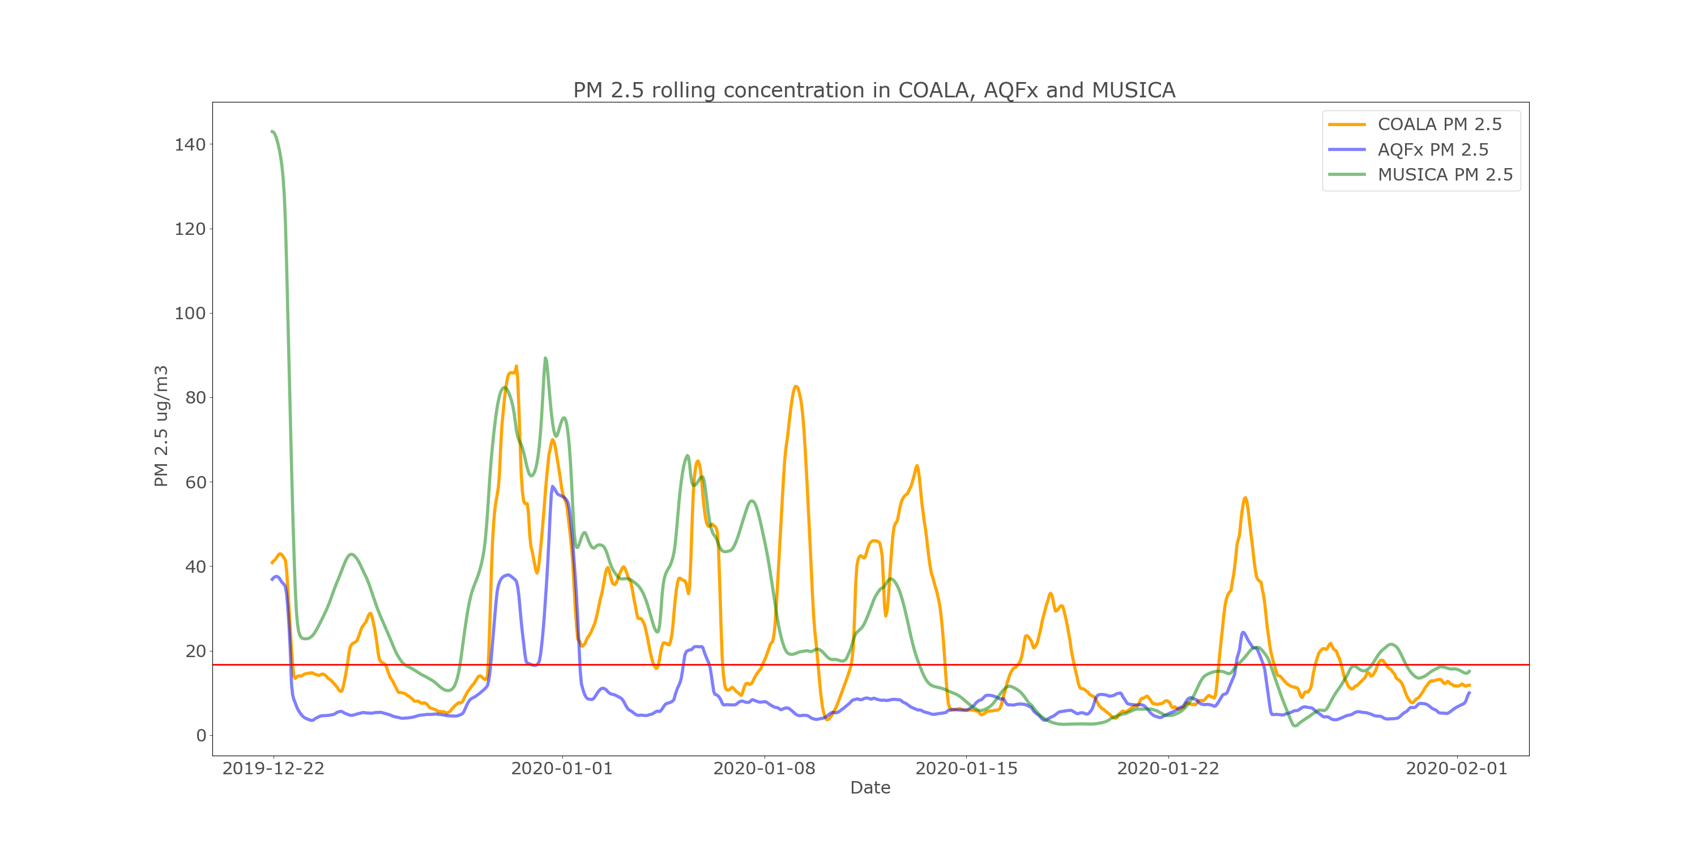
Quantitative Comparison of PM 2.5
Regulatory exceedance level 16.75 µg/m³

Slide 23
Exceedance Criteria of PM 2.5
Confusion Matrix Heatmap for PM 2.5 in AQFx
Confusion Matrix Heatmap for PM 2.5 in MUSICA
127
355
374
108
True Positive
False Negative
True Positive
False Negative
0
532
171
361
False Positive
True Negative
False Positive
True Negative
Green shading indicates where the model was correct
Red shading indicates where the model was incorrect

Slide 24
Exceedance Criteria of PM 2.5
Confusion Matrix Heatmap for PM 2.5 in AQFx
Confusion Matrix Heatmap for PM 2.5 in MUSICA
127
355
374
108
True Positive
False Negative
True Positive
False Negative
This time, no false positives
0
532
171
361
False Positive
True Negative
False Positive
True Negative
Green shading indicates where the model was correct
Red shading indicates where the model was incorrect

Slide 25
Exceedance Criteria of PM 2.5
Metric | AQFx | MUSICA
Accuracy | 0.65 | 0.72
Precision | 1.0 | 0.69
Recall | 0.26 | 0.78
F1 Score | 0.42 | 0.73

Slide 26
Summary
Using COALA-2020 measurements as a point of comparison, the results for ozone and PM2.5 for AQFx and MUSICA were compared.
The AQFx most accurately reproduces ozone levels, while MUSICA co-varies with COALA-2020 measurements but tends to overestimate high concentration levels consistently.
PM 2.5 simulations were generally worse, AQFx values are very low so no false positives lead to a high precision, but MUSICA performs best in all other fields
In-person visit on 4-15 August 2025
sam.lee2@unsw.edu.au

Slide 27
Thank you!
Thank you to Julie Noonan (CSIRO Australia) and Rebecca Buchholz (NSF National Center for Atmospheric Research) for providing data for this work
References
Canadell, J. G., Meyer, C. P. (Mick), Cook, G. D., Dowdy, A., Briggs, P. R., Knauer, J., et al. (2021). Multi-decadal increase of forest burned area in Australia is linked to climate change. Nature Communications, 12(1), 6921. https://doi.org/10.1038/s41467-021-27225-4
Filkov, A. I., Ngo, T., Matthews, S., Telfer, S., & Penman, T. D. (2020). Impact of Australia’s catastrophic 2019/20 bushfire season on communities and environment. Retrospective analysis and current trends. Journal of Safety Science and Resilience, 1(1), 44–56. https://doi.org/10.1016/j.jnlssr.2020.06.009
Reisen, F. (2024). AQFx- a national smoke forecasting system: From emissions to forewarning. Conference Presentation for 2024 CASANZ AirTalks, accessed 06 June 2025.
Image from https://wwf.org.au/what-we-do/australian-bushfires/, accessed 31 May 2025.
Imagery provided by services from NASA's Global Imagery Browse Services (GIBS), part of NASA's Earth Science Data and Information System (ESDIS), https://worldview.earthdata.nasa.gov
Leung, D. M., Kok, J. F., Li, L., Mahowald, N. M., Lawrence, D. M., Tilmes, S., et al. (2024). A new process-based and scale-aware desert dust emission scheme for global climate models – Part II: Evaluation in the Community Earth System Model version 2 (CESM2). Atmospheric Chemistry and Physics, 24(4), 2287–2318. https://doi.org/10.5194/acp-24-2287-2024
https://www2.acom.ucar.edu/sections/multi-scale-infrastructure-chemistry-modeling-musica

Slide 28
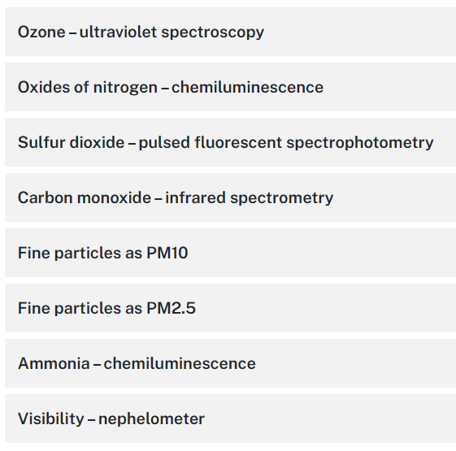
Air Quality Monitoring Station
https://www.environment.nsw.gov.au/topics/air/air-quality-basics/how-and-why-we-monitor-air-pollution
Filter deposition, then measured by microbalance or Beta Radiation Attenuation

